Slide 1
JAVA PROGRAMMING
Chap 6 : Exception Handling

Slide 2
Exception handling refers to handling of abnormal or unexpected events.
Some of these exceptions are known to the compiler while some other occur during runtime and are unknown to the compiler.
The Exception Handling in Java is one of the powerful mechanism to handle the runtime errors such as ClassNotFoundException, IOException, SQLException, RemoteException, etc. so that the normal flow of the application can be maintained.
Exceptions can be caught and handled by the program.
When an exception occurs within a method, it creates an object.
This object is called the exception object.
It contains information about the exception, such as the name and description of the exception and the state of the program when the exception occurred.
Major reasons why an exception Occurs
Invalid user input
Device failure
Loss of network connection
Physical limitations (out of disk memory)
Code errors
Opening an unavailable file

Slide 3
Errors represent irrecoverable conditions such as Java virtual machine (JVM) running out of memory, memory leaks, stack overflow errors, library incompatibility, infinite recursion, etc.
Errors are usually beyond the control of the programmer, and we should not try to handle errors.
When executing Java code, different errors can occur: coding errors made by the programmer, errors due to wrong input, or other unforeseeable things.
When an error occurs, Java will normally stop and generate an error message. The technical term for this is: Java will throw an exception (throw an error).
“Exception” is a class and has subclasses according to the exceptions possible in Java.
Eg: If a integer is expected while taking input and instead if a character is entered, then while parsing, error will occur. This error is called NumberFormatException. It is one of the subclass of the base class Exception.
Exceptions are classified as :
Built-in Exceptions
Checked Exception
Unchecked Exception
User-Defined Exceptions

Slide 4
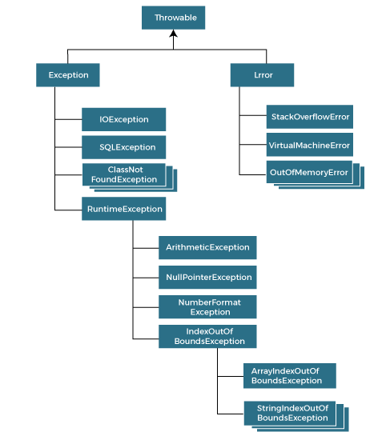
The java.lang.Throwable class is the root class of Java Exception hierarchy inherited by two subclasses: Exception and Error.
All exception and error types are subclasses of class Throwable, which is the base class of the hierarchy.
One branch is headed by Exception. This class is used for exceptional conditions that user programs should catch. NullPointerException is an example of such an exception.
Another branch, Error is used by the Java run-time system(JVM) to indicate errors having to do with the run-time environment itself(JRE). StackOverflowError is an example of such an error.

Slide 5
Built-in Exceptions
Built-in exceptions are the exceptions that are available in Java libraries. These exceptions are suitable to explain certain error situations.
Checked Exception : The classes that directly inherit the Throwable class except RuntimeException and Error are known as checked exceptions. For example, IOException, SQLException, etc. Checked exceptions are checked at compile-time.
Checked exceptions are called compile-time exceptions because these exceptions are checked at compile-time by the compiler.
Checked Exceptions make the programmers to handle the exception that may be thrown.
There are two ways to deal with an exception :
Indicate that the method throws an exception
Method must catch the exception and take appropriate action using the try catch block
Unchecked Exception : The classes that inherit the RuntimeException are known as unchecked exceptions. For example, ArithmeticException, NullPointerException, ArrayIndexOutOfBoundsException, etc.
The unchecked exceptions are just opposite to the checked exceptions. The compiler will not check these exceptions at compile time, but they are checked at runtime.
In simple words, if a program throws an unchecked exception, and even if we didn’t handle or declare it, the program would not give a compilation error.
Hence the programmers may not even know that such an exception would be thrown

Slide 6
Built-in Exceptions
There are given some scenarios where unchecked exceptions may occur. They are as follows:
If we divide any number by zero, there occurs an ArithmeticException.
int a=50/0;//ArithmeticException
If we have a null value in any variable, performing any operation on the variable throws a NullPointerException.
String s=null;
System.out.println(s.length());//NullPointerException
If the formatting of any variable or number is mismatched, it may result into NumberFormatException. Suppose we have a string variable that has characters; converting this variable into digit will cause NumberFormatException.
String s="abc";
int i=Integer.parseInt(s);//NumberFormatException
When an array exceeds to it's size, the ArrayIndexOutOfBoundsException occurs
int a[]=new int[5];
a[10]=50; //ArrayIndexOutOfBoundsException

Slide 7
User defined Exceptions
Sometimes, the built-in exceptions in Java are not able to describe a certain situation. In such cases, users can also create exceptions, which are called ‘user-defined Exceptions’.
The advantages of Exception Handling in Java are as follows:
Provision to Complete Program Execution
Easy Identification of Program Code and Error-Handling Code
Propagation of Errors
Meaningful Error Reporting
Identifying Error Types

Slide 8
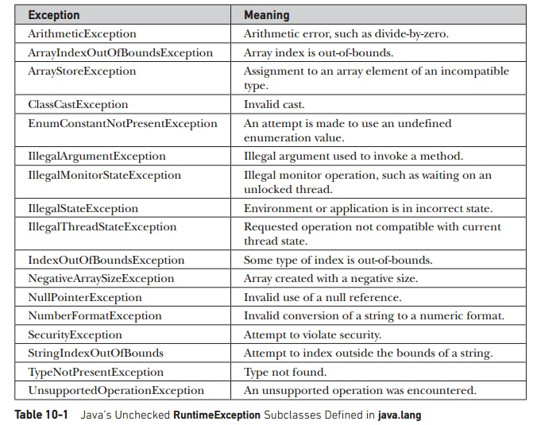
Java’s Unchecked Exceptions

Slide 9
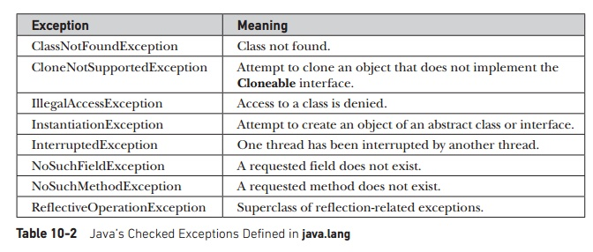
Java’s Checked Exceptions

Slide 10
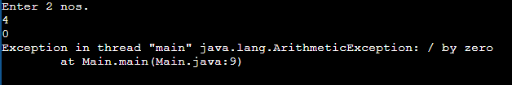
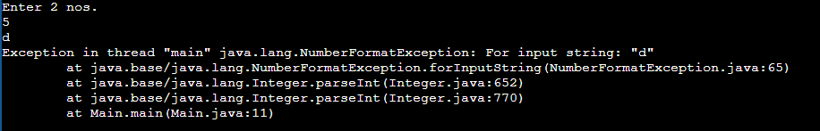
WAP to perform division of two numbers accepted from the user to demonstrate ArithmeticException and NumberFormatException.
import java.io.*;
class Main{
public static void main(String args[])throws IOException{
int a,b,res;
BufferedReader sc=new BufferedReader (new InputStreamReader (System.in));
System.out.println("Enter 2 nos.");
a=Integer.parseInt(sc.readLine());
b=Integer.parseInt(sc.readLine());
res=a/b;
System.out.println("The Result is : "+res);
}
}
ArithmeticException →
NumberFormatException →

Slide 11
Java Exception Keywords
Java provides five keywords that are used to handle the exception. The following table describes each.
Keyword | Description
try | The "try" keyword is used to specify a block where we should place an exception code. It means we can't use try block alone. The try block must be followed by either catch or finally.
catch | The "catch" block is used to handle the exception. It must be preceded by try block which means we can't use catch block alone. It can be followed by finally block later.
finally | The "finally" block is used to execute the necessary code of the program. It is executed whether an exception is handled or not.
throw | The "throw" keyword is used to throw an exception.
throws | The "throws" keyword is used to declare exceptions. It specifies that there may occur an exception in the method. It doesn't throw an exception. It is always used with method signature.

Slide 12
try-catch-finally
Try Block :
The statements that are prone to generate errors or exception are placed in try block.
If an exception occurs then the catch block will be executed and then the finally block will be executed.
Else if no exception occurs, then the control will directly go to the finally block i.e. the catch block will not be executed.
The java code that you think can generate an exception is placed in the try catch block to handle the error.
If an exception occurs but a matching catch block is not found then it reaches to the finally block.
In any case, when the exception occurs in a particular statement of try block, the remaining statements of the try block after this statement are not executed i.e. no statements of the try block are executed after the exception generating statement.
Catch Block :
The exception thrown by the try block are caught by the catch block.
The type of the exception occurred must match with the exception mentioned in the brackets of the catch block.
Finally Block :
A finally block is always executed irrespective of whether the exception occurred or not
It is an optional block. It is not necessary to have a finally block i.e. you may just have try catch blocks.

Slide 13
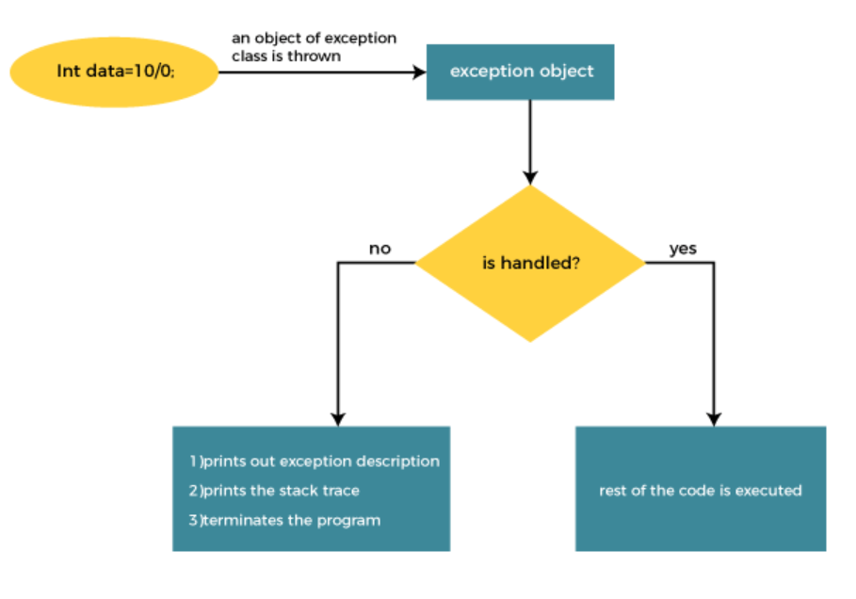
Internal Working of Java try-catch block

Slide 14
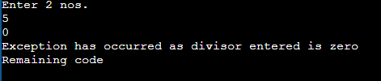
WAP to perform division of two numbers accepted from the user to demonstrate ArithmeticException using try catch block.
import java.io.*;
class Main{
public static void main(String args[]) throws IOException{
int a,b,res;
BufferedReader sc=new BufferedReader (new InputStreamReader (System.in));
System.out.println("Enter 2 nos.");
a=Integer.parseInt(sc.readLine());
b=Integer.parseInt(sc.readLine());
try {
res=a/b;
System.out.println("The Result is : "+res);
}
catch (ArithmeticException ae)
{System.out.println("Exception has occurred as divisor entered is zero");
}
System.out.println("Remaining code");
}
}

Slide 15
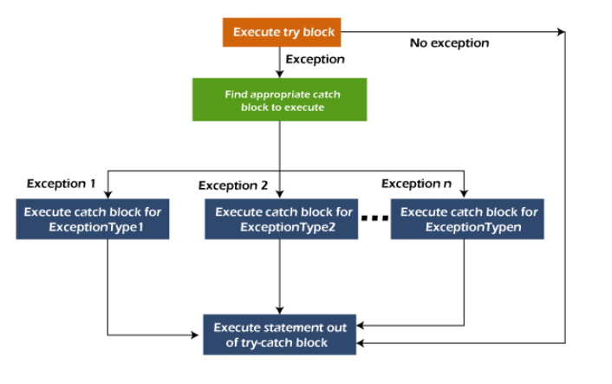
Multiple catch blocks
A try block can be followed by one or more catch blocks. Each catch block must contain a different exception handler. So, if you have to perform different tasks at the occurrence of different exceptions, use java multi-catch block.
Points to remember
At a time only one exception occurs and at a time only one catch block is executed.
All catch blocks must be ordered from most specific to most general, i.e. catch for ArithmeticException must come before catch for Exception.

Slide 16
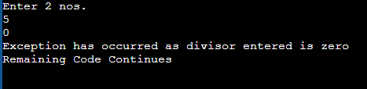
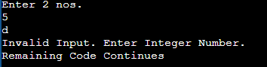
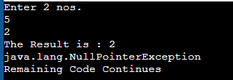
WAP to perform division of two numbers accepted from the user to demonstrate ArithmeticException and NumberFormatException using try catch block.
import java.io.*;
class Main{
public static void main(String args[]) throws IOException{
int a=0,b=0,res;
BufferedReader sc=new BufferedReader (new InputStreamReader (System.in));
try {
System.out.println("Enter 2 nos.");
a=Integer.parseInt(sc.readLine());
b=Integer.parseInt(sc.readLine());
res=a/b;
System.out.println("The Result is : "+res);
String s=null;
System.out.println(s.length());
}
catch (ArithmeticException ae) {
System.out.println("Exception has occurred as divisor entered is zero");
}
catch (NumberFormatException ne) {
System.out.println("Invalid Input. Enter Integer Number.");
}
catch(Exception e) {
System.out.println(e);
}
System.out.println("Remaining Code Continues");
} }

Slide 17
Nested try blocks
Sometimes a situation may arise where a part of a block may cause one error and the entire block itself may cause another error. In such cases, exception handlers have to be nested.
In Java, using a try block inside another try block is permitted. It is called as nested try block.
Every statement that we enter a statement in try block, context of that exception is pushed onto the stack.
For example, the inner try block can be used to handle ArrayIndexOutOfBoundsException while the outer try block can handle the ArithemeticException (division by zero).
....
//main try block
try
{
statement 1;
statement 2;
//try catch block within another try block
try
{
statement 3;
statement 4;
//try catch block within nested try block
try
{
statement 5;
statement 6;
}
catch(Exception e2)
{
//exception message of 2nd nested try block
}
}
catch(Exception e1)
{
//exception message of 1st nested try block
}
}
catch(Exception e3)
{
//exception message of parent (outer) try block
}
....

Slide 18
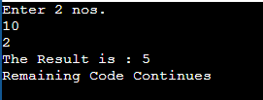
WAP to perform division of two numbers accepted from the user to demonstrate ArithmeticException and NumberFormatException using nested try catch block.
import java.io.*;
class Main{
public static void main(String args[]) throws IOException{
int a=0,b=0,res;
BufferedReader sc=new BufferedReader (new InputStreamReader (System.in));
try {
System.out.println("Enter 2 nos.");
a=Integer.parseInt(sc.readLine());
b=Integer.parseInt(sc.readLine());
try {
res=a/b;
System.out.println("The Result is : "+res);
}
catch (ArithmeticException ae) { System.out.println("Exception has occurred as divisor entered is zero");
}
}
catch (NumberFormatException ne) {
System.out.println("Invalid Input. Enter Integer Number.");
}
System.out.println("Remaining Code Continues");
}
}

Slide 19
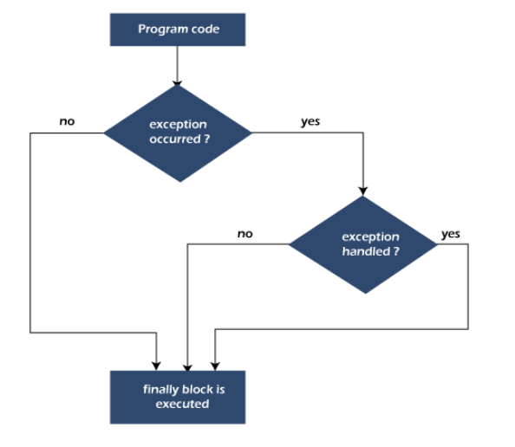
Internal Working of Java try-catch-finally block
A finally block is always executed irrespective of whether the exception occurred or not
It is an optional block. It is not necessary to have a finally block i.e. you may just have try catch blocks.
finally block in Java can be used to put "cleanup" code such as closing a file, closing connection, etc.
The important statements to be printed can be placed in the finally block.

Slide 20



WAP to perform division of two numbers accepted from the user to demonstrate ArithmeticException and NumberFormatException using try-catch-finally block.
import java.io.*;
class Main{
public static void main(String args[]) throws IOException{
int a=0,b=0,res;
BufferedReader sc=new BufferedReader (new InputStreamReader (System.in));
try {
System.out.println("Enter 2 nos.");
a=Integer.parseInt(sc.readLine());
b=Integer.parseInt(sc.readLine());
try {
res=a/b;
System.out.println("The Result is : "+res);
}
catch (ArithmeticException ae)
{ System.out.println("Exception has occurred as divisor entered is zero");
}
}
catch (NumberFormatException ne)
{ System.out.println("Invalid Input. Enter Integer Number.");
}
finally {
System.out.println("Finally block executed");
}
}
}

Slide 21
“throws” keyword
The Java throws keyword is used to declare an exception.
It gives an information to the programmer that there may occur an exception. So, it is better for the programmer to provide the exception handling code so that the normal flow of the program can be maintained.
Exception Handling is mainly used to handle the checked exceptions.
Syntax of Java throws
return_type method_name() throws exception_class_name{
//method code
}
throws keyword in Java is used in the signature of method to indicate that this method might throw one of the listed type (i.e. checked) exceptions. The caller to these methods has to handle the exception using a try-catch block.
Important points to remember about throws keyword:
throws keyword is required only for checked exception and usage of throws keyword for unchecked exception is meaningless.
throws keyword is required only to convince compiler and usage of throws keyword does not prevent abnormal termination of program.
By the help of throws keyword we can provide information to the caller of the method about the exception.

Slide 22

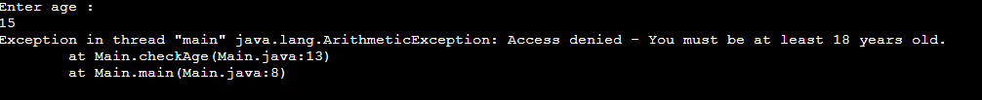
WAP to demonstrate throws keyword.
import java.util.*;
public class Main {
public static void main(String[] args) {
int a;
System.out.println("Enter age :");
Scanner sc=new Scanner(System.in);
a=sc.nextInt();
checkAge(a);
}
static void checkAge(int age) throws ArithmeticException {
if (age < 18) {
throw new ArithmeticException("Access denied - You must be at least 18 years old.");
}
else
{
System.out.println("Access granted - You are old enough!");
}
}
}

Slide 23
“throw” keyword
The Java throw keyword is used to throw an exception explicitly.
We specify the exception object which is to be thrown. The Exception has some message with it that provides the error description. These exceptions may be related to user inputs, server, etc.
We can throw either checked or unchecked exceptions in Java by throw keyword.
It is mainly used to throw a custom exception i.e. you can make your own conditions to throw exceptions.
It will not be a built in exception but it will be your user defined exception.

Slide 24


WAP to accept and display month number. Throw a NumberFormatException if month number exceeds 12 or is less than 0.
import java.util.*;
class Main{
public static void main(String args[]){
int m;
Scanner sc=new Scanner(System.in);
System.out.println("Enter month number");
m=sc.nextInt();
try {
if(m<1 || m>12)
throw new NumberFormatException();
System.out.println("The entered month number is : "+m);
}
catch (NumberFormatException ne)
{ System.out.println("Invalid month number.");
}
}
}

Slide 25
WAP to accept and display month number. Throw an Exception if month number exceeds 12 or is less than 0. Make your own exception class to handle this exception.
import java.util.*;
class MonthNumberException extends Exception {
MonthNumberException()
{
System.out.println("Invalid Month Number");
}
}
class Main{
public static void main(String args[]){
int m;
Scanner sc=new Scanner(System.in);
System.out.println("Enter month number");
m=sc.nextInt();
try {
if(m<1 || m>12)
throw new MonthNumberException();
System.out.println("The entered month number is : "+m);
}
catch (MonthNumberException me)
{
}
}
}

Slide 26
